Slide 1

Capstone Project

Slide 2



Personal BACKGROUND
(Name, Past Experience, Qualification, Career Summary)
Name : Swetha K
Past Experience : NA
Qualification : BE – Computer Science And Engineering
Career Summary:
I ‘m Backend Developer with a solid software development background. I am skilled in Java, quick to pick up new technologies, and work well in team settings. I am committed to learning continuously and improving my skills to contribute effectively to any project or organization.
www.collaberadigital.com

Slide 3


Key Takeaways/Learnings from the Program (HTD)
Key Learnings
Spring Boot: Developed microservices and used Spring Data JPA for ORM.
Core & Advanced Java: Strengthened understanding and implementation of Java programming.
AWS Integration: Deployed services on AWS EC2 and managed service discovery with Eureka.
Feign Client: Created declarative HTTP clients for inter-service communication.
Testing & QA: Conducted API testing with Postman, wrote unit tests with JUnit, and ensured code quality with Sonar-Lint.

Slide 4

Problem Statement of the Capstone Project
Overview:
Airplane Booking System needs an efficient system to handle airport operations, aircraft details, and passenger bookings. Current systems are often disconnected and rely on manual processes, causing inefficiencies, errors, and security concerns. This makes it difficult for administrators to keep things running smoothly, impacting overall performance and customer satisfaction.
Challenges:
Managing detailed information for airports, planes, and bookings with precision.
Relying on manual work leads to delays and mistakes.
Ensuring the protection of sensitive data and secure access for administrators.
The system needs to grow with increasing data and user demands.
Problems in connecting different services for smooth operation.

Slide 5
Problem Statement of the Capstone Project
Objective:
Develop a secure, scalable Air Transport System (ATS) using microservices with Spring Boot and AWS to improve the management of airports, planes, and bookings.
Key Features:
Centralized Platform: Unified management of airports, planes, and bookings.
Automated Processes: Auto-generation of IDs to reduce errors.
Strong Security: Enhanced security measures for data protection.
Scalable Architecture: Microservices with AWS for flexibility and scalability.
User-Friendly Interface: Easy-to-use interface for efficient management.
Outcome:
The ATS will streamline operations, reduce errors, enhance security, and improve efficiency, leading to better service quality and customer satisfaction.

Slide 6
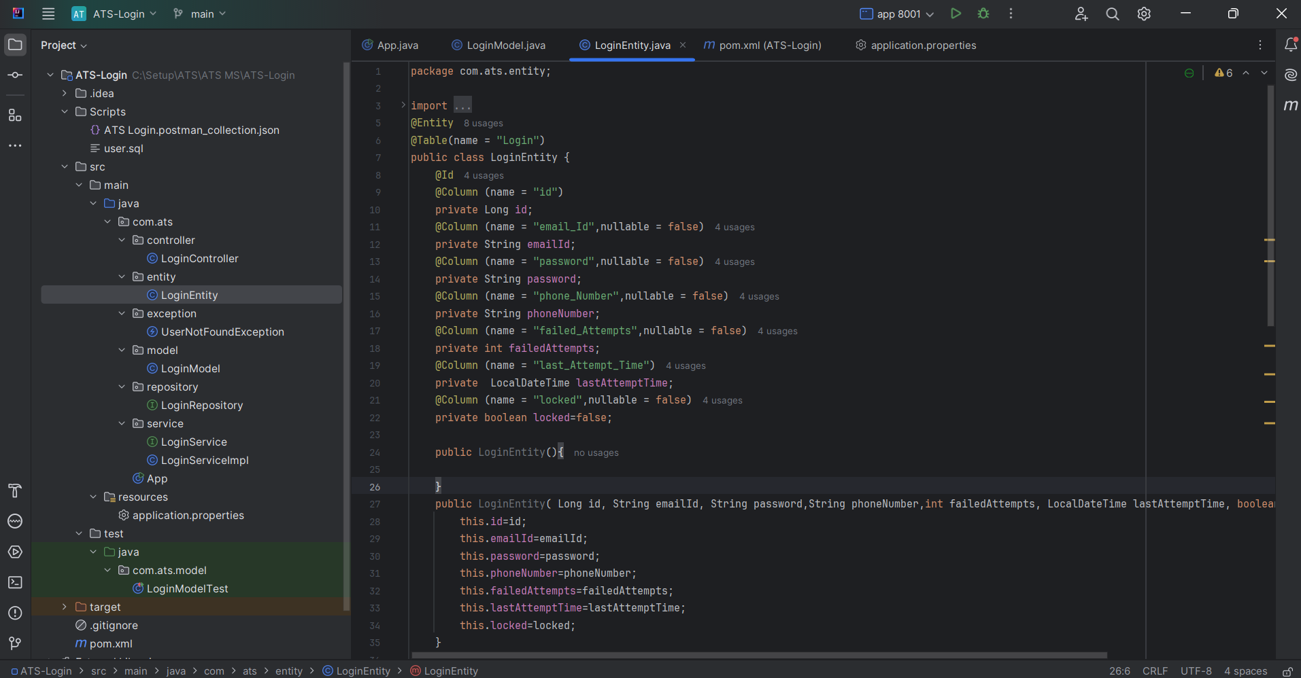
Screenshot of Login Micro-Service

Slide 7
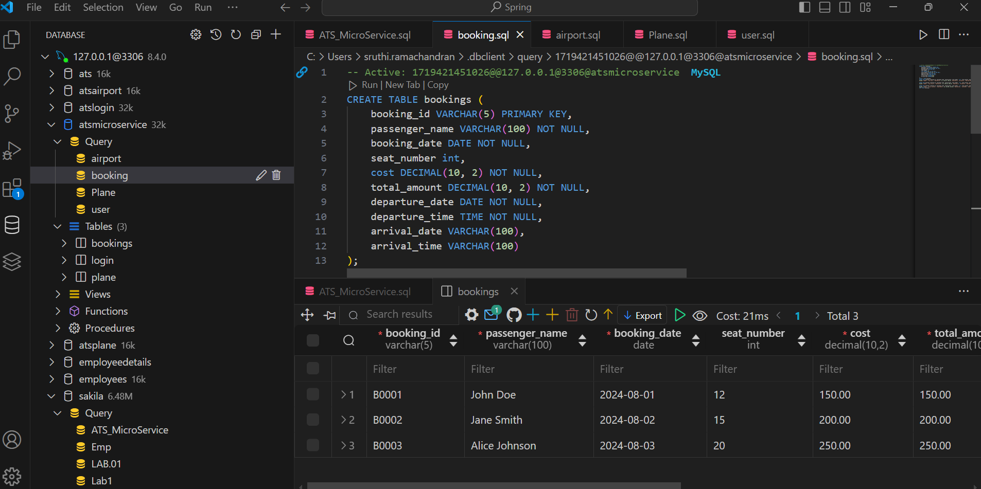
Screenshot of Database

Slide 8

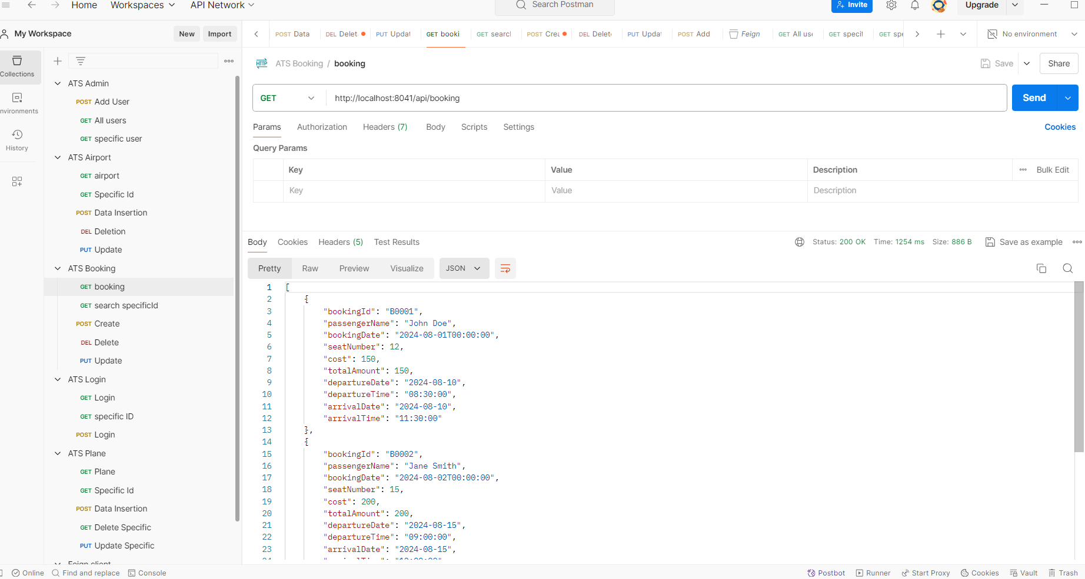
Screenshot of Postman

Slide 9

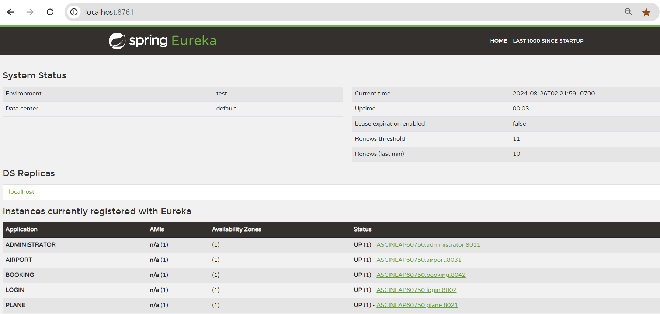
Screenshot of spring Eureka

Slide 10
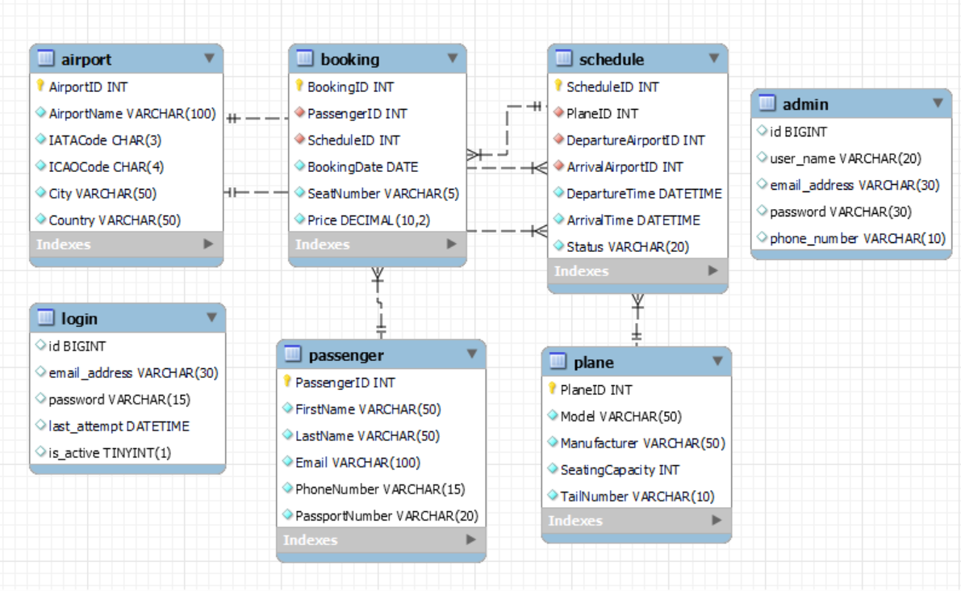
Entity-Relationship Diagram

Slide 11
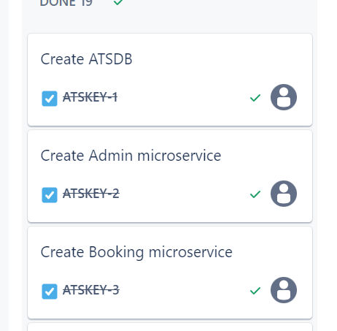
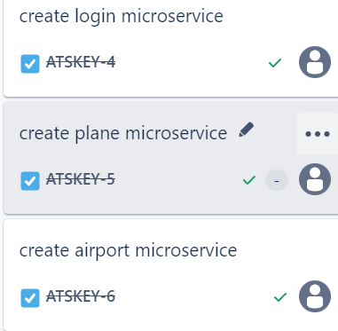
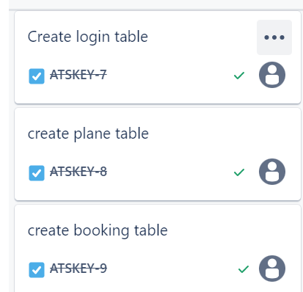
Screenshot of JIRA

Slide 12
Conclusion
The Air Transport System (ATS) project provides a scalable and secure platform for managing airport operations, aircraft details, and passenger bookings using a microservices architecture with Spring Boot.
It streamlines processes, minimizes errors, and enhances the user experience, leading to improved operational efficiency, increased security, and higher customer satisfaction.
ATS demonstrates the impact of advanced technology and best practices in software design on modernizing air transport management and driving future innovations in the aviation industry.

Slide 13
Thank You

